Slide 1
Line fitting

Slide 2
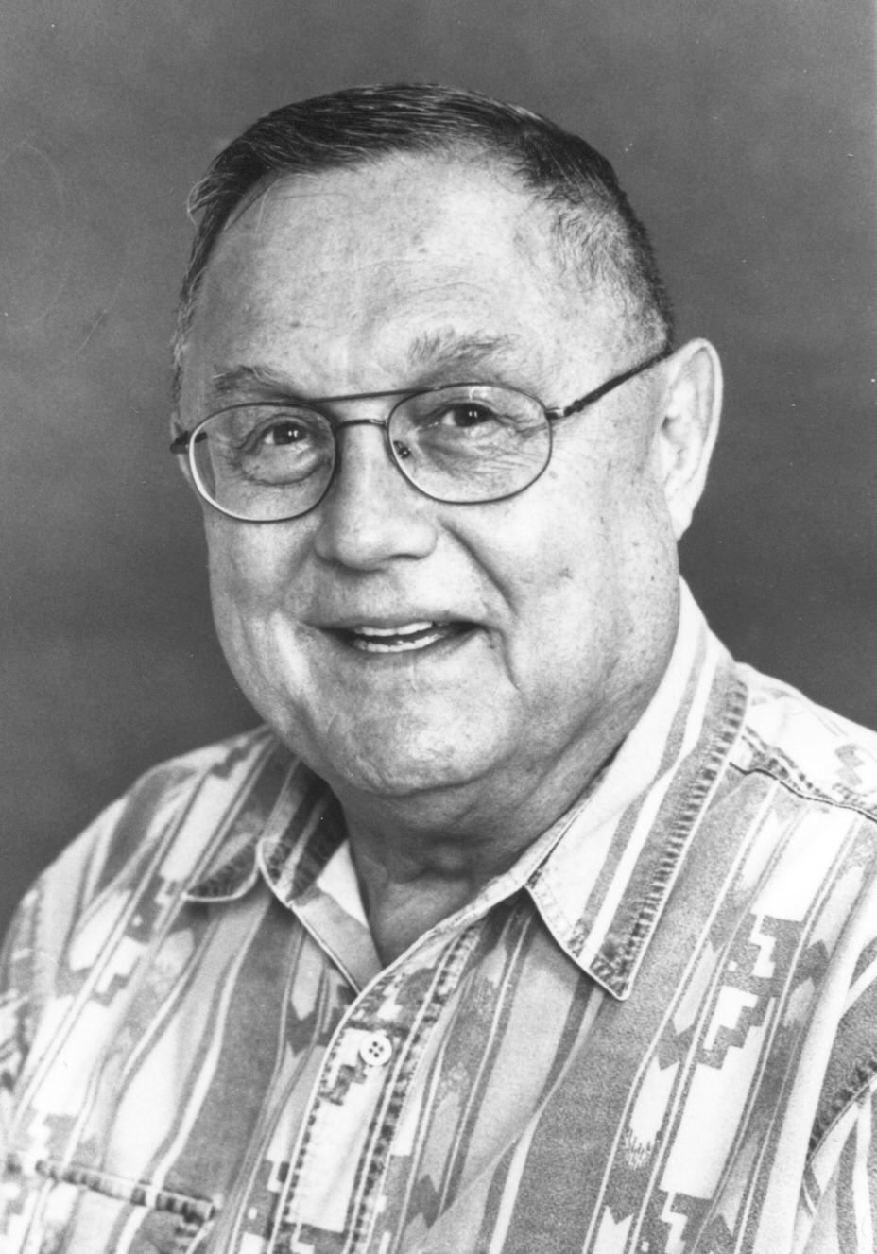
Jack Elton Bresenham
b. 1937
IBM /
Winthrop University
Bresenham's Line Algorithm (1962)

Slide 3
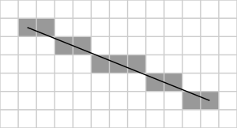
Line Tracing
Input:
(x₀,y₀) & (x₁,y₁)
Output:
Approximation of Coordinates on that line

Slide 4
Line Tracing
(x,y)
(x+dx,y+dy)

Slide 5
Line Tracing - Pseudocode
(x,y)
drawLineP(x,y,x+dx,y+dy)
// assume dx,dy>0
a=0, b=0
while a<=dx and b<=dy
drawPixel(x+a,y+b)
if a/dx <= b/dy
a++
else
b++
Works for positive dx and dy
(x+dx,y+dy)

Slide 6
Line Extraction
Split and merge
Linear regression
RANSAC
Hough-Transform

Slide 7
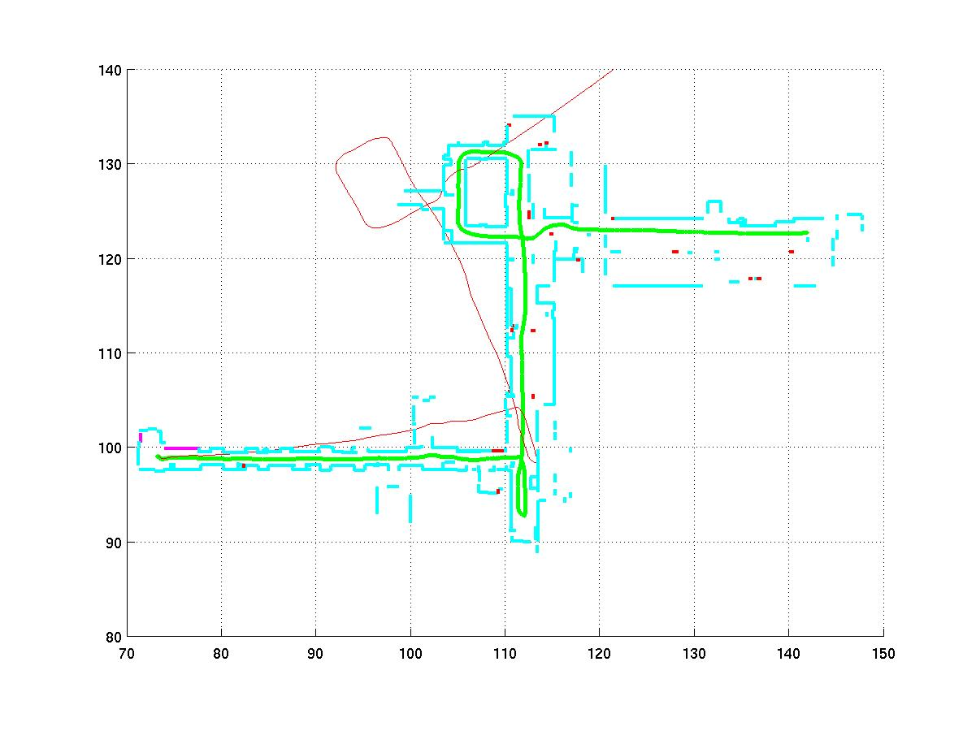
Line Extraction: Motivation
Map of the ASL hallway built using line segments

Slide 8
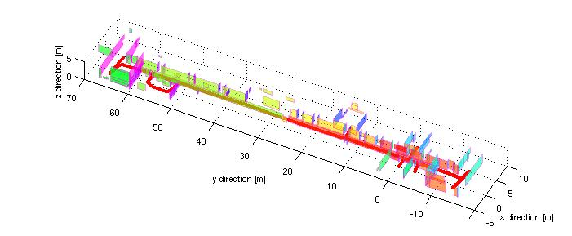
Line Extraction: Motivation
Map of the ASL hallway built using orthogonal planes constructed from line segments

Slide 9
Line Extraction: Motivation
Why laser scanner:
Dense and accurate range measurements
High sampling rate, high angular resolution
Good range distance and resolution.
Why line segment:
The simplest geometric primitive
Compact, requires less storage
Provides rich and accurate information
Represents most office-like environment.

Slide 10
Line Extraction: The Problem
Scan point in polar form: (ρ_{i}, θ_{i})
Assumptions:
Gaussian noise with (0, σ) for ρ
Negligible angular uncertainty
Line model in polar form:
x cos α + y sin α = r
-π < α <= π
r >= 0
r
α

Slide 11
Line Extraction: The Problem (2)
Three main problems:
How many lines ?
Which points belong to which line ?
This problem is called SEGMENTATION
Given points that belong to a line, how to estimate the line parameters ?
This problem is called LINE FITTING
The Algorithms we will see:
Split and merge
Linear regression
RANSAC
Hough-Transform

Slide 12
Algorithm 1: Split-and-Merge (standard)
The most popular algorithm which is originated from computer vision.
A recursive procedure of fitting and splitting.
A slightly different version, called Iterative-End-Point-Fit, simply connects the end points for line fitting.

Slide 13
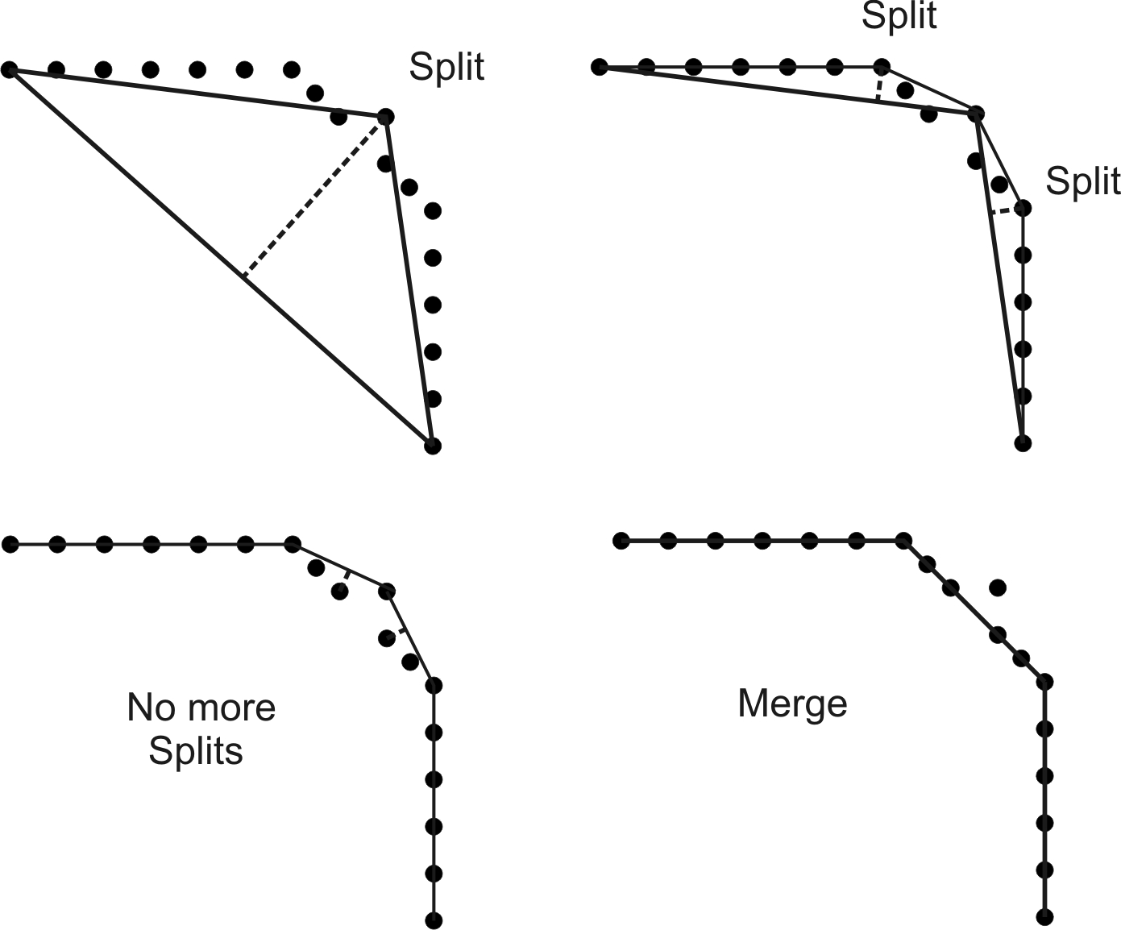
Algorithm 1: Split-and-Merge (Iterative-End-Point-Fit)

Slide 14
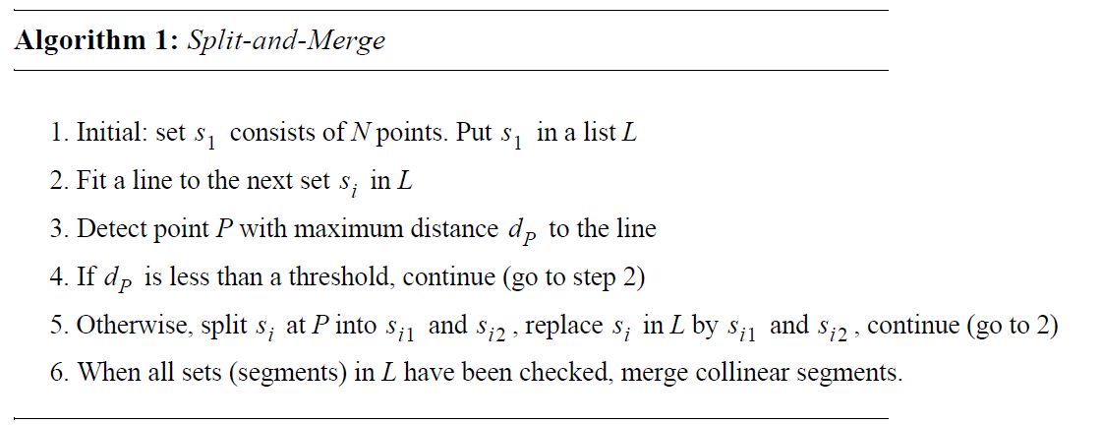
Algorithm 1: Split-and-Merge

Slide 15
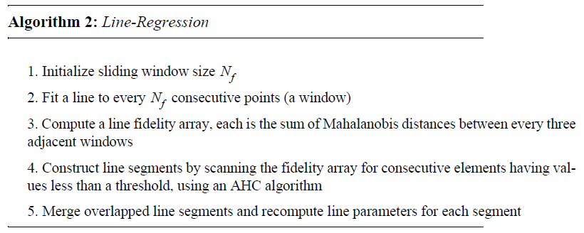
Algorithm 2: Line-Regression

Slide 16
Algorithm 3: RANSAC
Acronym of Random Sample Consensus.
It is a generic and robust fitting algorithm of models in the presence of outliers (points which do not satisfy a model)
RANSAC is not restricted to line extraction from laser data but it can be generally applied to any problem where the goal is to identify the inliers which satisfy a predefined mathematical model.
Typical applications in robotics are: line extraction from 2D range data (sonar or laser); plane extraction from 3D range data, and structure from motion
RANSAC is an iterative method and is non-deterministic in that the probability to find a line free of outliers increases as more iterations are used
Drawback: A nondeterministic method, results are different between runs.

Slide 17
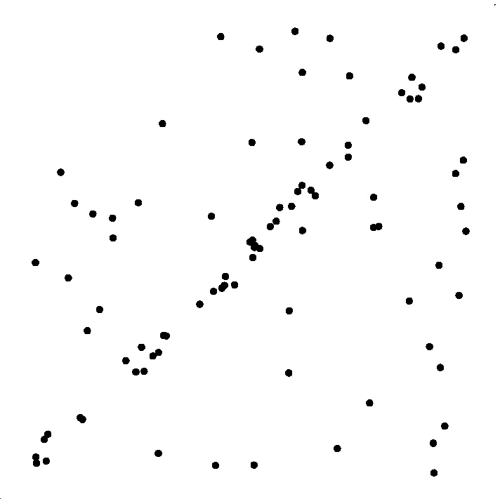
Algorithm 3: RANSAC

Slide 18
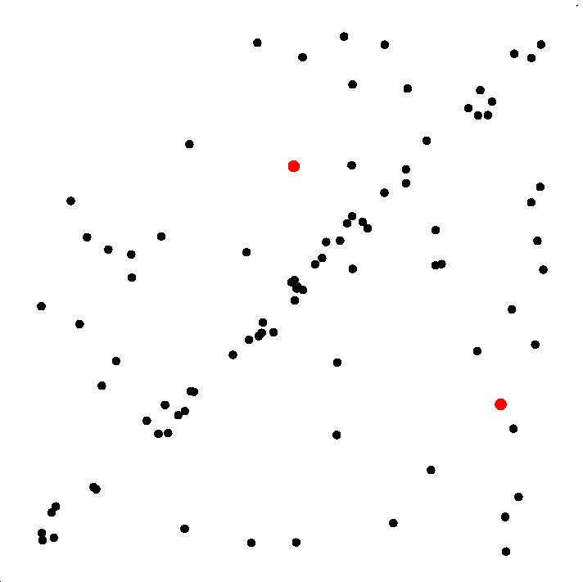
Algorithm 3: RANSAC
Select sample of 2 points at random

Slide 19
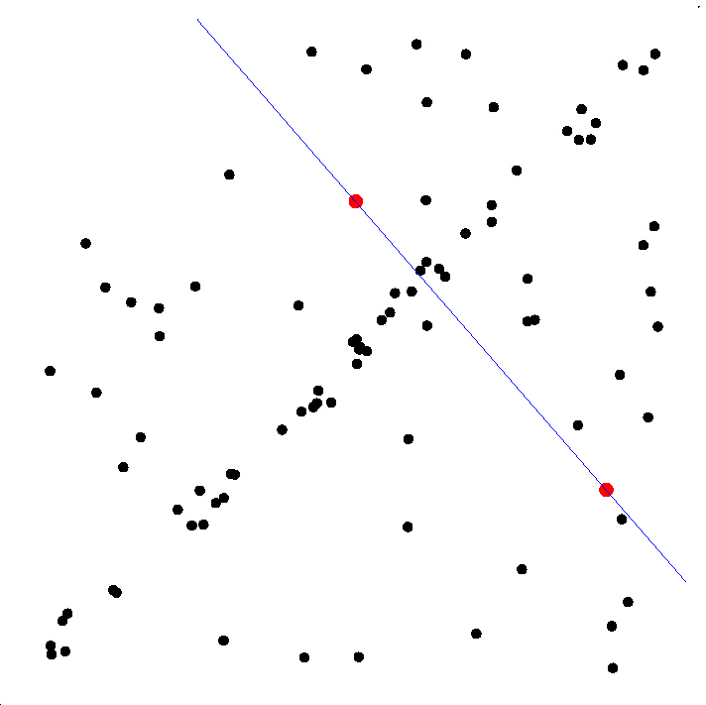
Algorithm 3: RANSAC
Select sample of 2 points at random
Calculate model parameters that fit the data in the sample

Slide 20
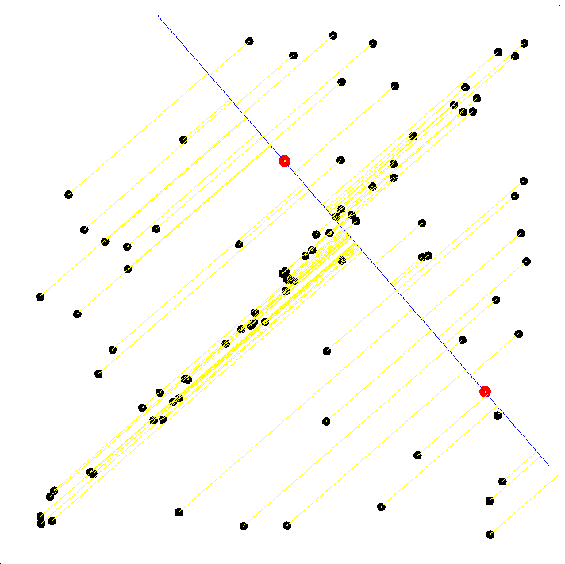
RANSAC
Select sample of 2 points at random
Calculate model parameters that fit the data in the sample
Calculate error function for each data point

Slide 21
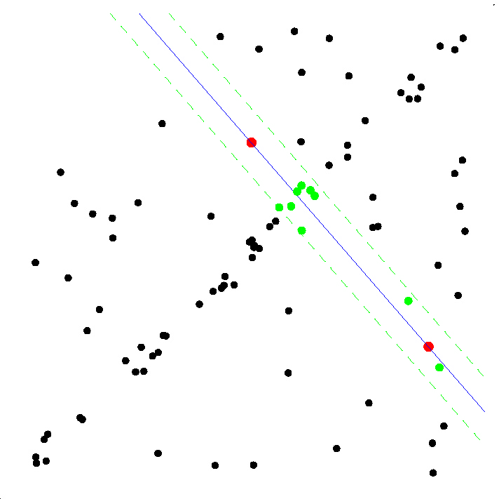
Algorithm 3: RANSAC
Select sample of 2 points at random
Calculate model parameters that fit the data in the sample
Calculate error function for each data point
Select data that support current hypothesis

Slide 22
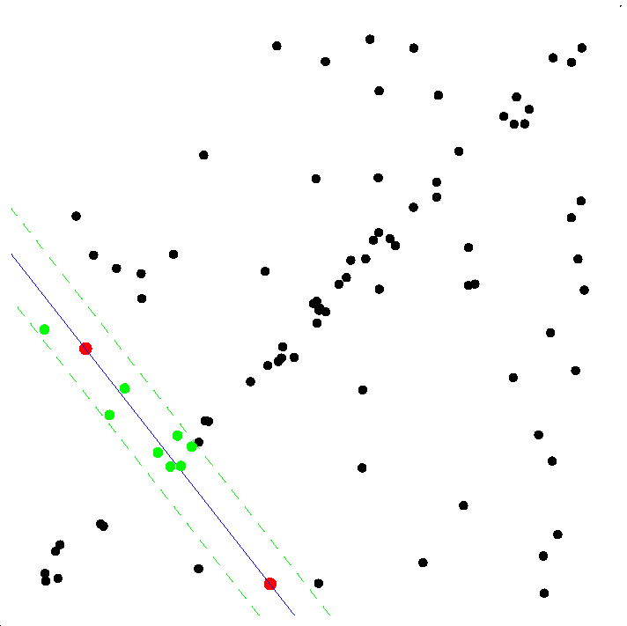
Algorithm 3: RANSAC
Select sample of 2 points at random
Calculate model parameters that fit the data in the sample
Calculate error function for each data point
Select data that support current hypothesis
Repeat sampling

Slide 23
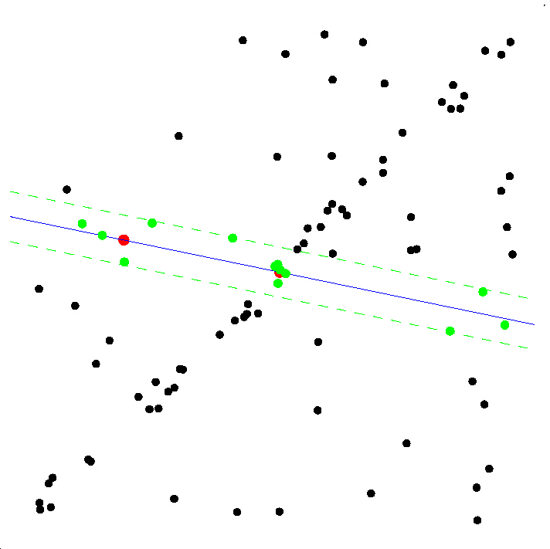
Algorithm 3: RANSAC
Select sample of 2 points at random
Calculate model parameters that fit the data in the sample
Calculate error function for each data point
Select data that support current hypothesis
Repeat sampling

Slide 24
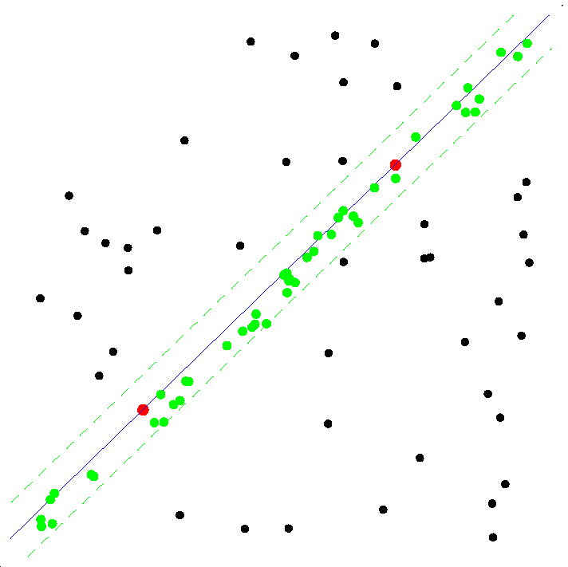
Algorithm 3: RANSAC
ALL-INLIER SAMPLE

Slide 25
Algorithm 3: RANSAC
How many iterations does RANSAC need?
Because we cannot know in advance if the observed set contains the maximum number of inliers, the ideal would be to check all possible combinations of 2 points in a dataset of N points.
The number of combinations is given by N(N-1)/2, which makes it computationally unfeasible if N is too large. For example, in a laser scan of 360 points we would need to check all 360*359/2= 64,620 possibilities!
Do we really need to check all possibilities or can we stop RANSAC after iterations? The answer is that indeed we do not need to check all combinations but just a subset of them if we have a rough estimate of the percentage of inliers in our dataset
This can be done in a probabilistic way

Slide 26
Algorithm 3: RANSAC
How many iterations does RANSAC need?
Let w be the fraction of inliers in the data. w = number of inliers / N where N is the total number of points. w represents also the probability of selecting an inlier
Let p be the probability of finding a set of points free of outliers
If we assume that the two points needed for estimating a line are selected independently, w² is the probability that both points are inliers and 1-w² is the probability that at least one of these two points is an outlier
Now, let k be the number of RANSAC iterations executed so far, then (1-w²) ^{k} will be the probability that RANSAC never selects two points that are both inliers. This probability must be equal to (1-p). Accordingly, 1-p = (1-w²) ^{k} and therefore

Slide 27
Algorithm 3: RANSAC
How many iterations does RANSAC need?
The number of iterations k is
This expression tells us that knowing the fraction of inliers w, after k RANSAC iterations we will have a probability p of finding a set of points free of outliers. For example, if we want a probability of success equal to p=99% and the we know that the percentage of inliers in the dataset is w=50%, then we get k=16 iterations, which is much less than the number of all possible combinations that we had to check in the previous example! Also observe that in practice we do not need a precise knowledge of the fraction of inliers but just a rough estimate. More advanced implementations of RANSAC estimate the fraction of inliers by changing it adaptively iteration after iteration.

